Slide 1
18ECP101L
MASSIVE OPEN ONLINE COURSE(MOOC) - I
PLATFORM – COURSERA
Course - Introduction to Systems Engineering
DONE BY – RA2011004010051 (Kunal Keshan) - ECE A

Slide 2
Course Details
COURSE PLATFORM- Coursera
COURSE TITLE- Introduction to Systems Engineering
OFFERED By- UNSW Sydney
DURATION – 9 Weeks

Slide 3
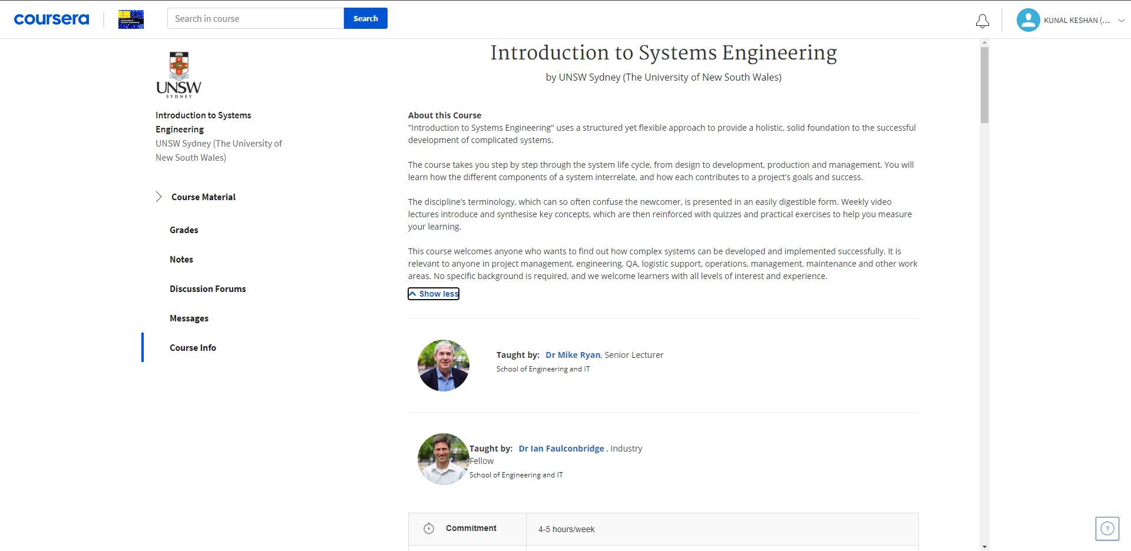
About this Course

Slide 4
Introduction
"Introduction to Systems Engineering" uses a structured yet flexible approach to provide a holistic, solid foundation to the successful development of complicated systems.
The course takes you step by step through the system life cycle, from design to development, production and management. You will learn how the different components of a system interrelate, and how each contributes to a project’s goals and success.
The discipline’s terminology, which can so often confuse the newcomer, is presented in an easily digestible form. Weekly video lectures introduce and synthesise key concepts, which are then reinforced with quizzes and practical exercises to help you measure your learning.

Slide 5
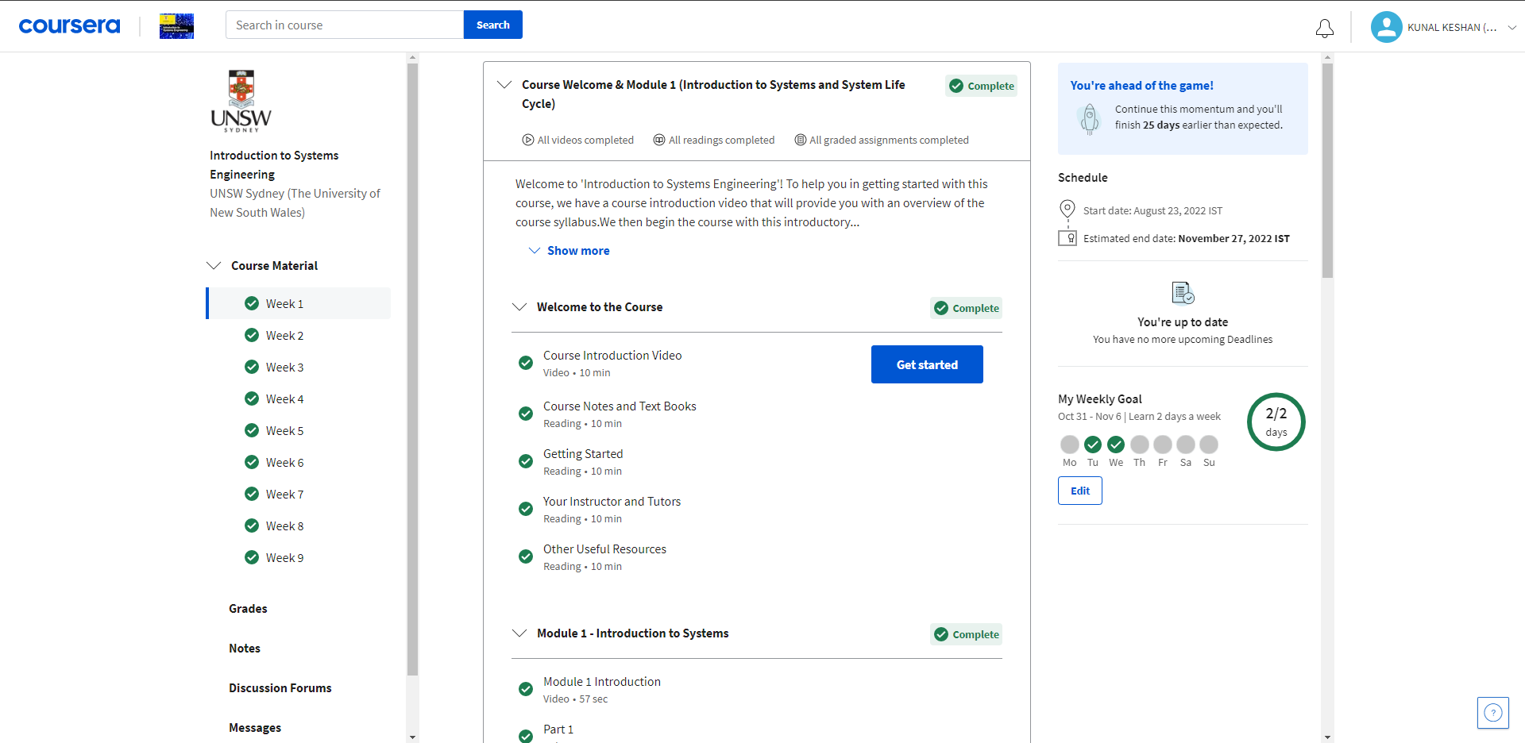
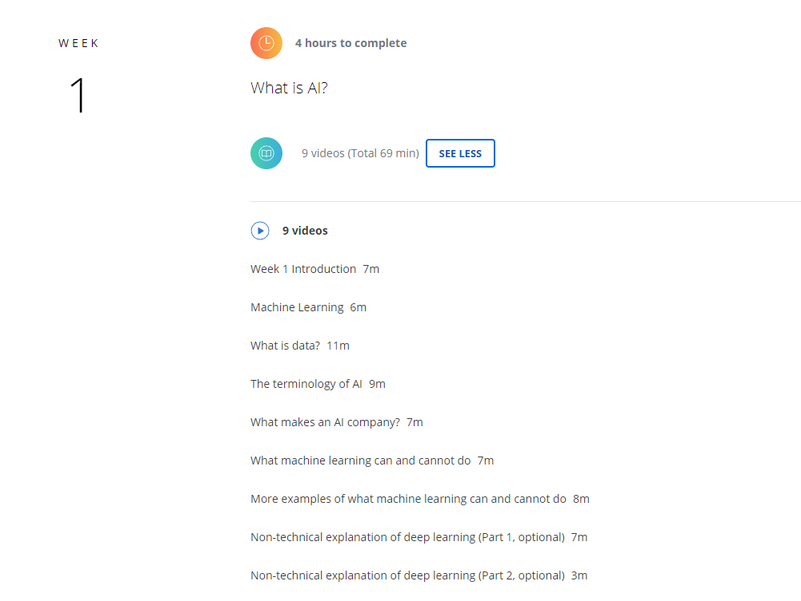
Week 1

Slide 6
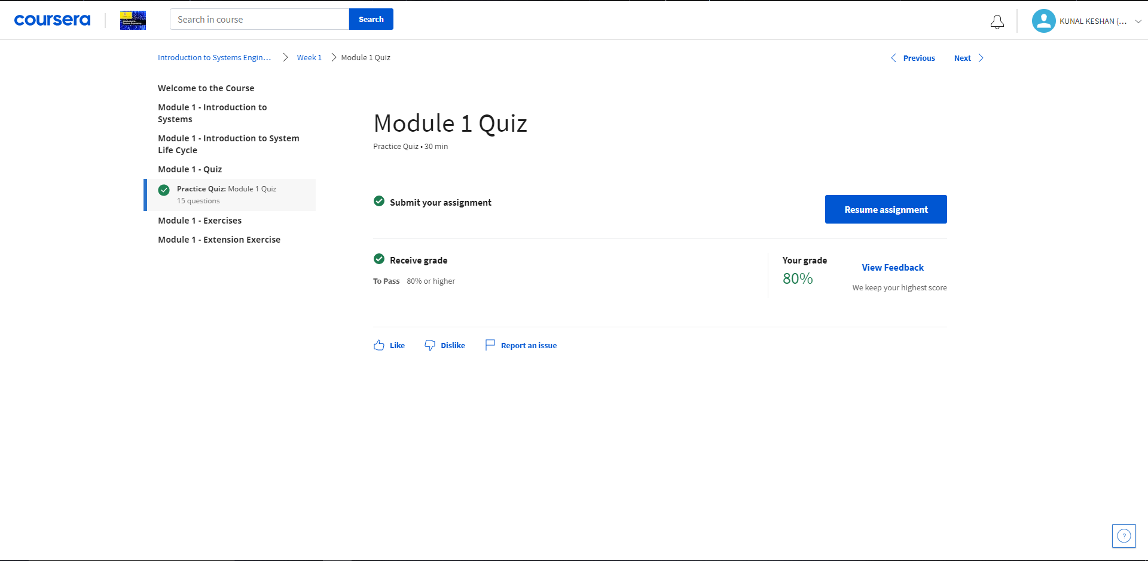
Week 1

Slide 7
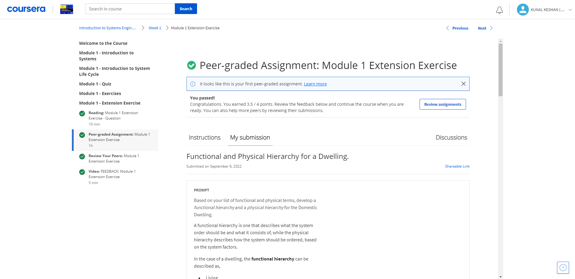
Week 1

Slide 8
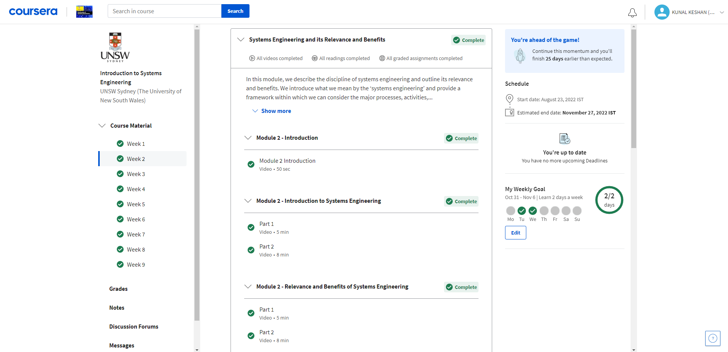
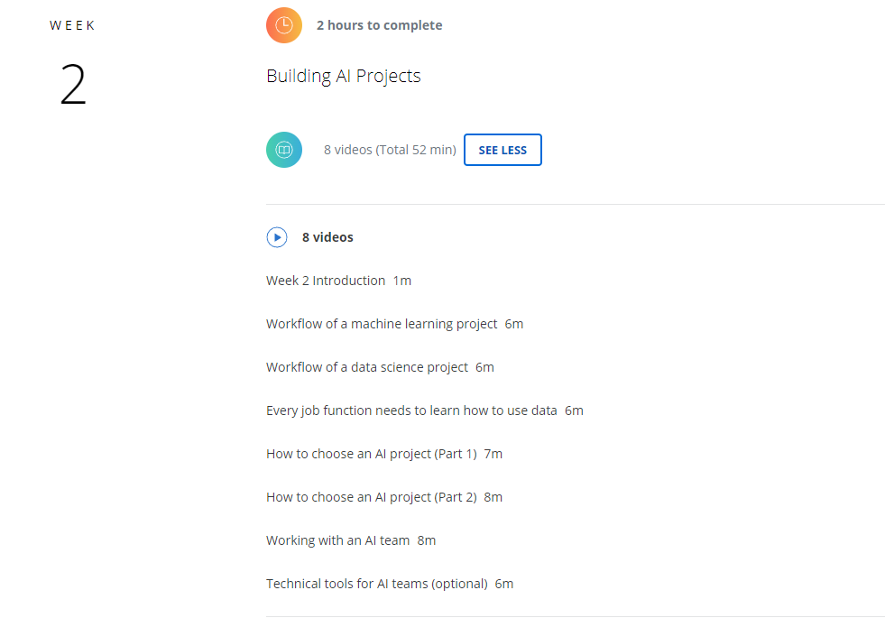
Week 2

Slide 9
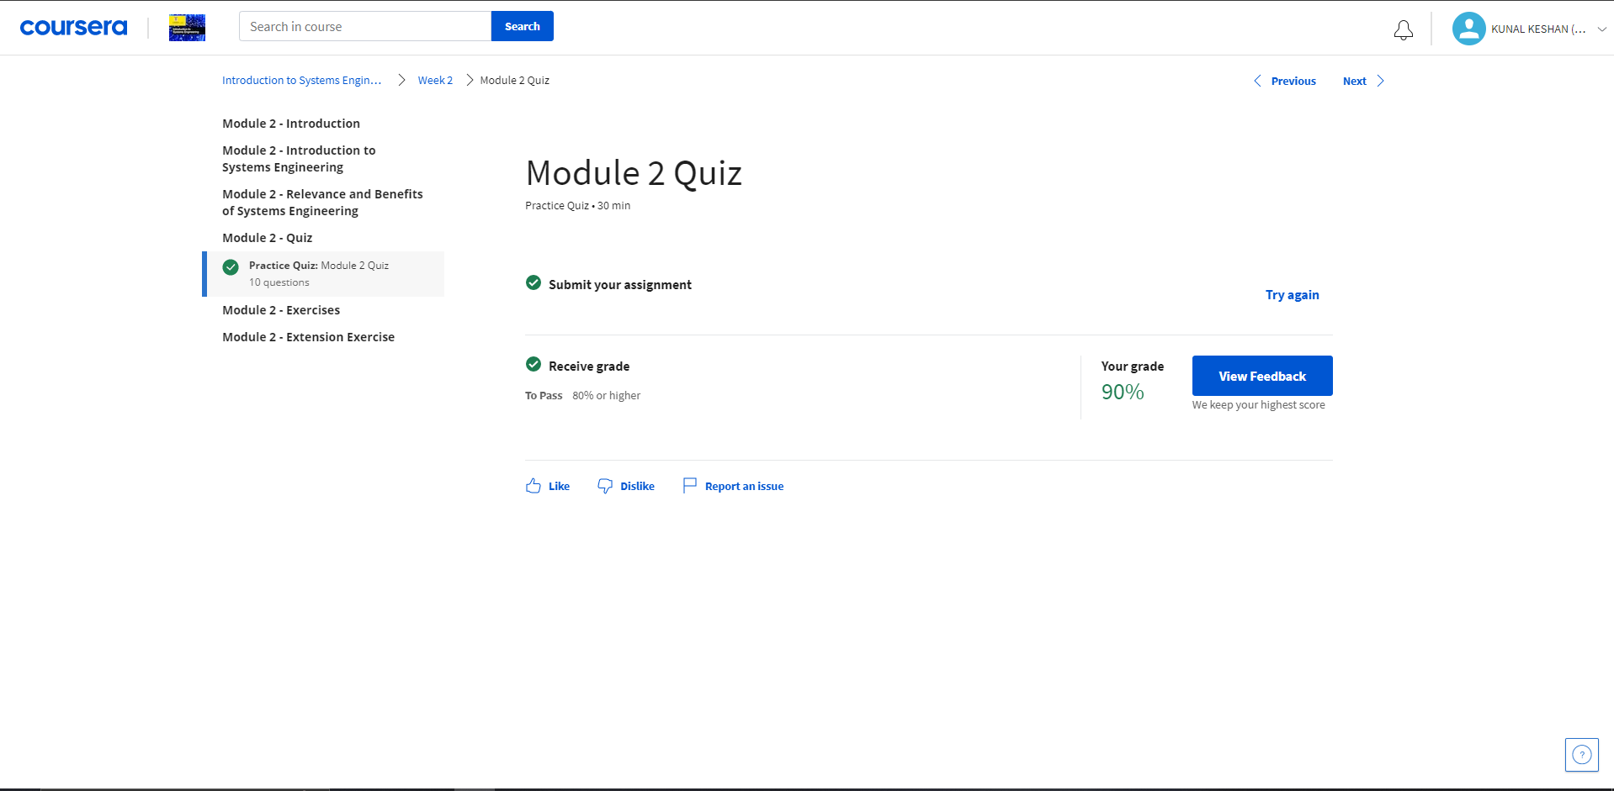
Week 2

Slide 10
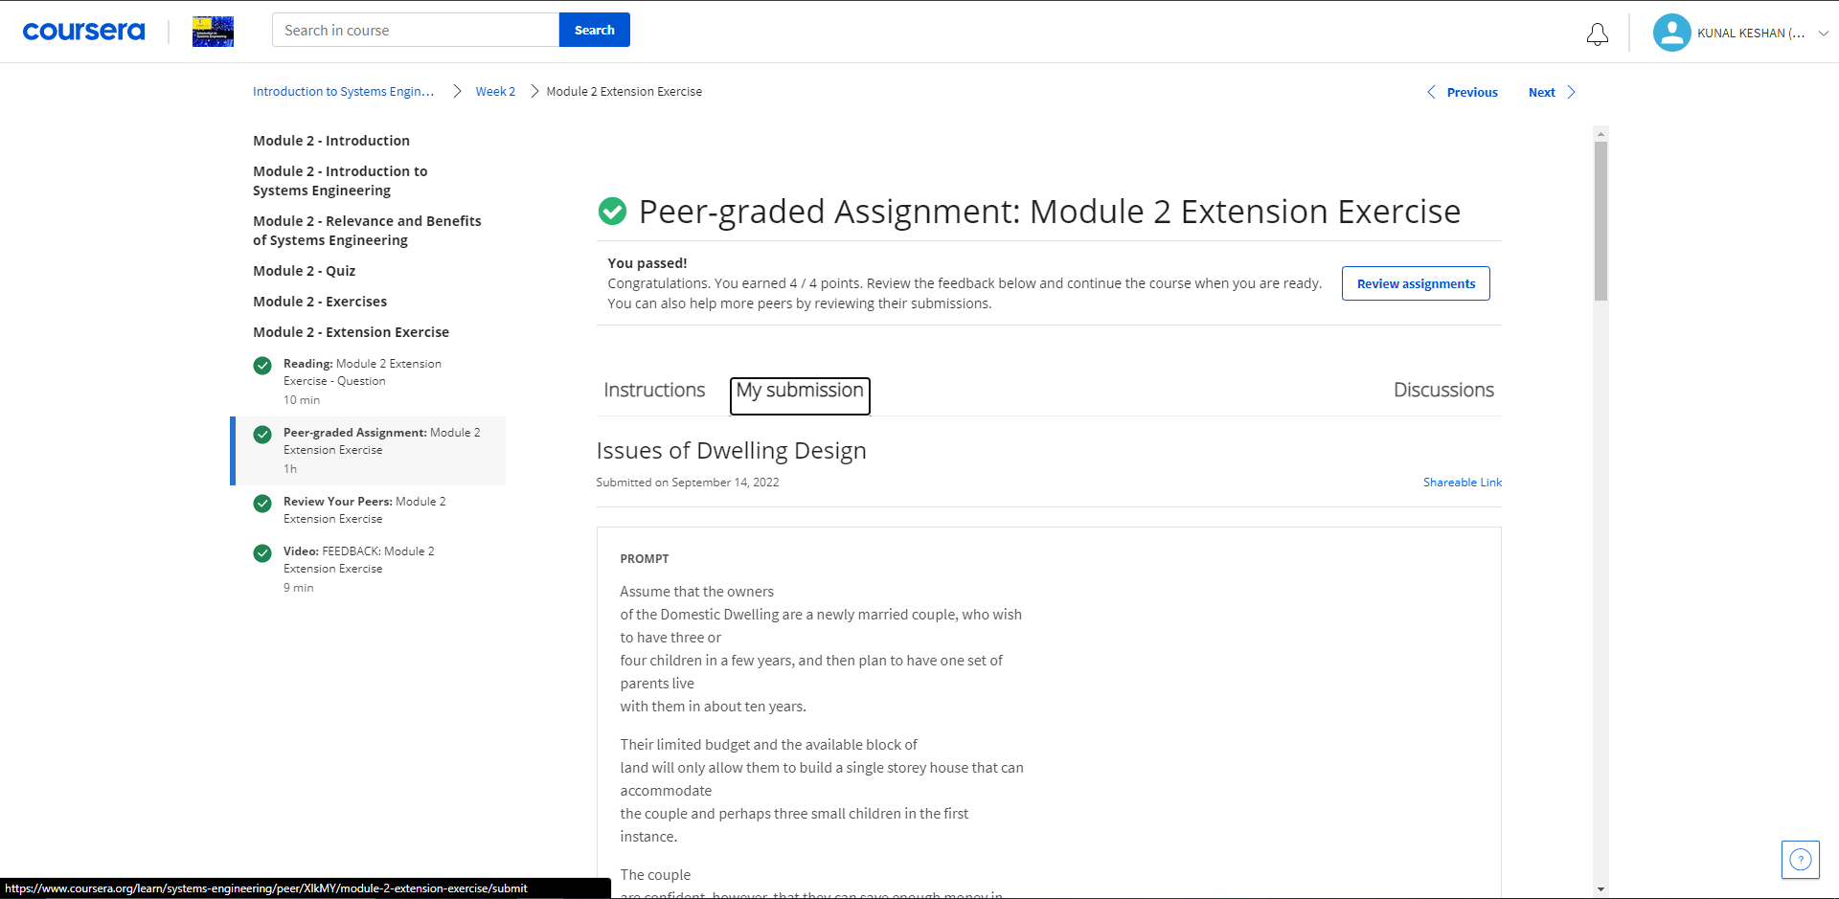
Week 2

Slide 11
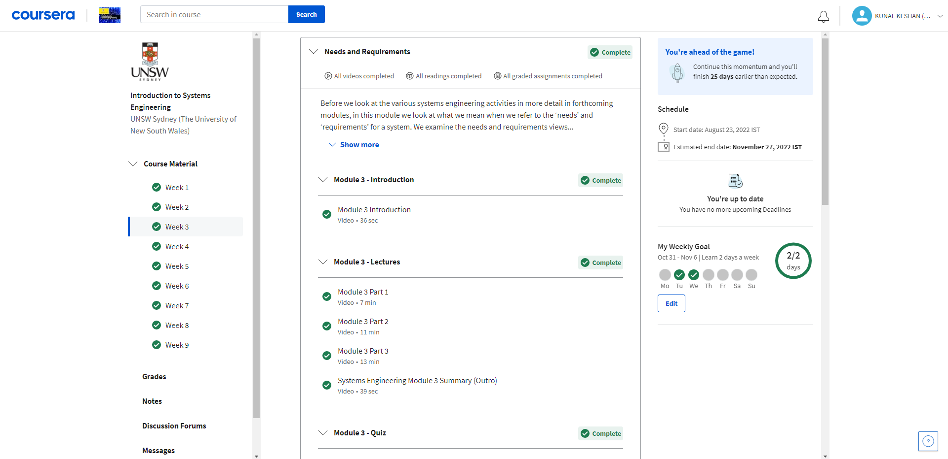
Week 3

Slide 12
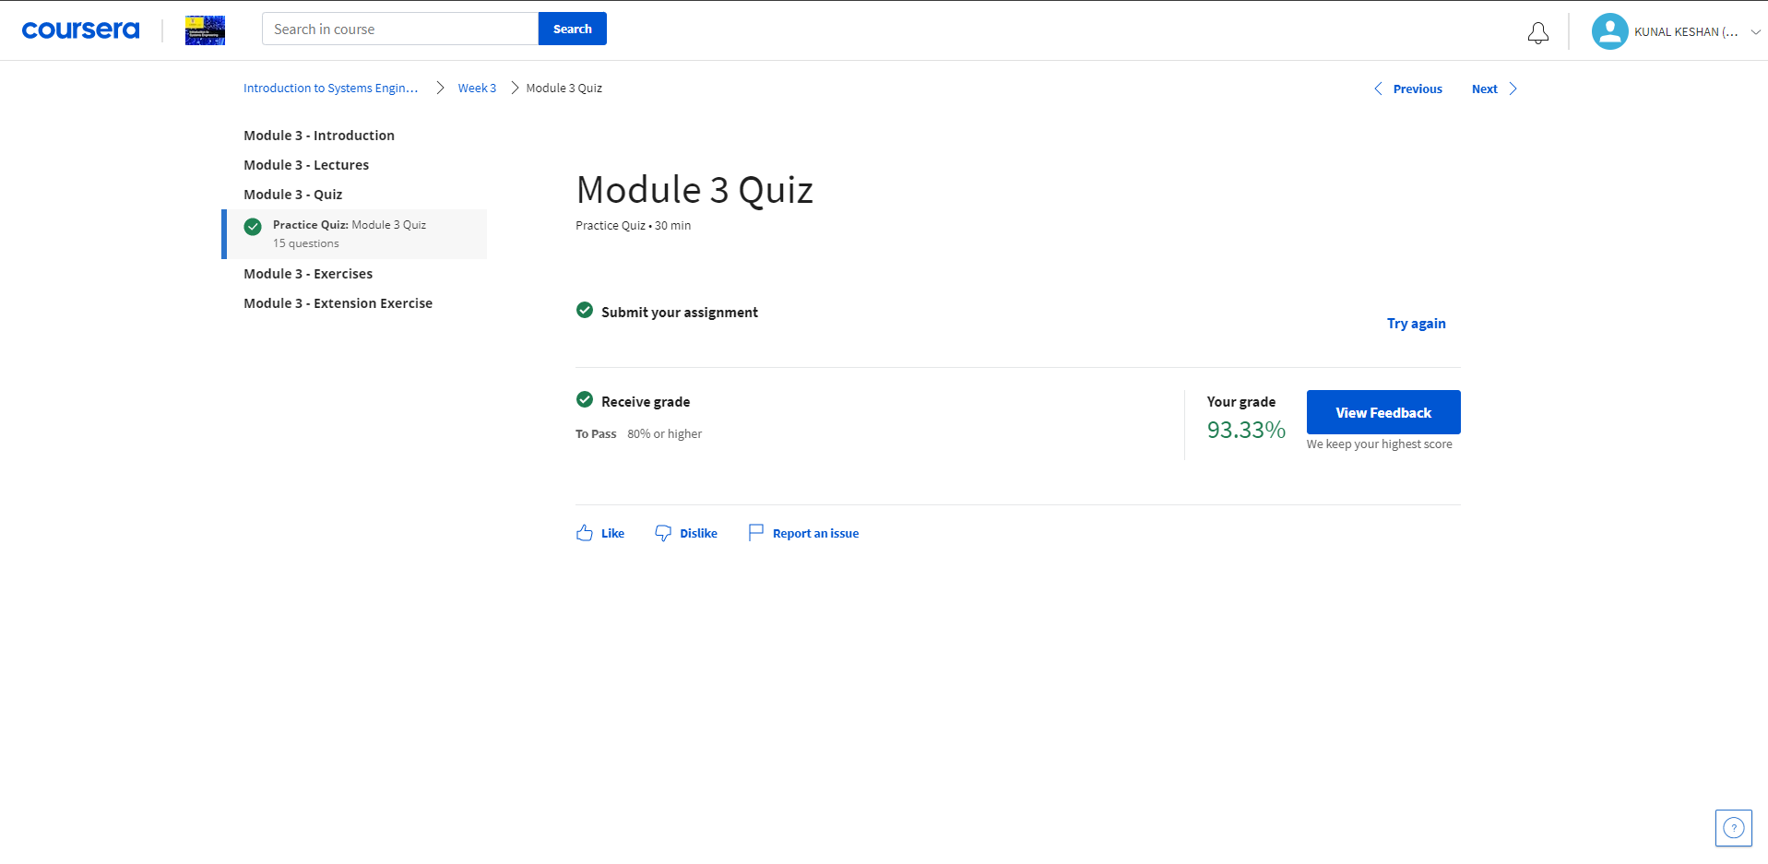
Week 3

Slide 13
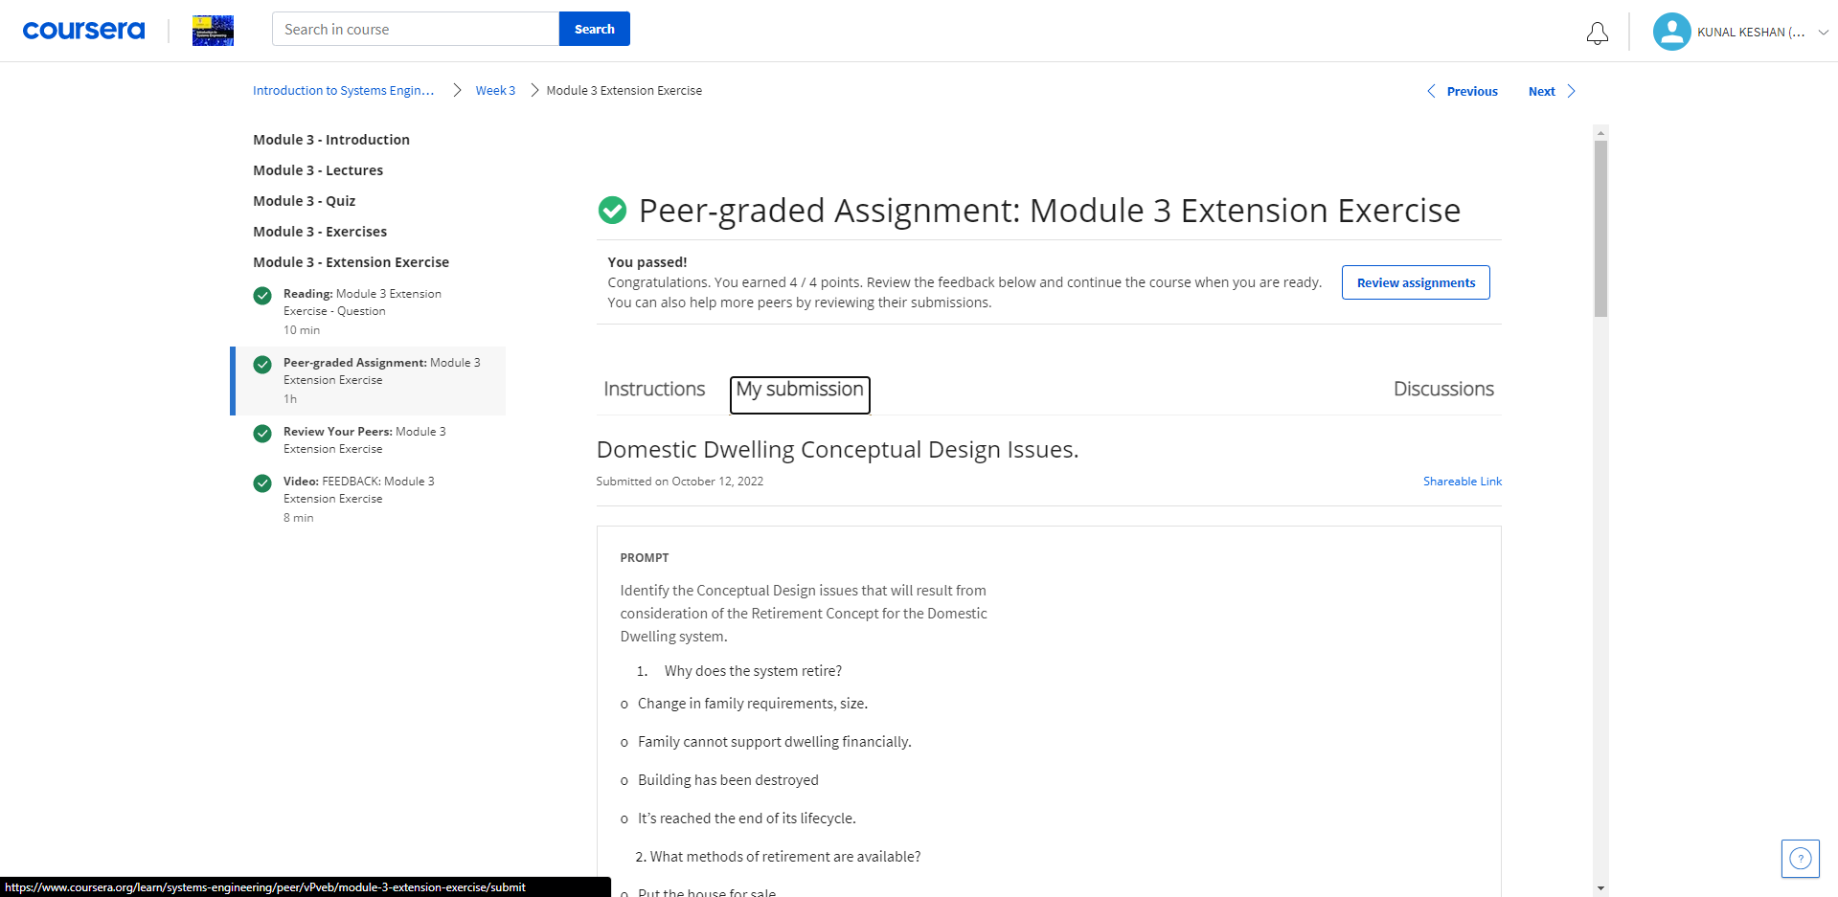
Week 3

Slide 14
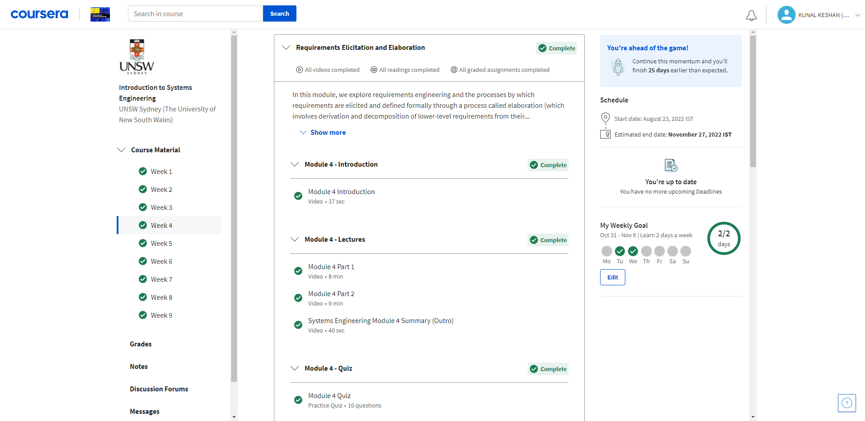
Week 4

Slide 15
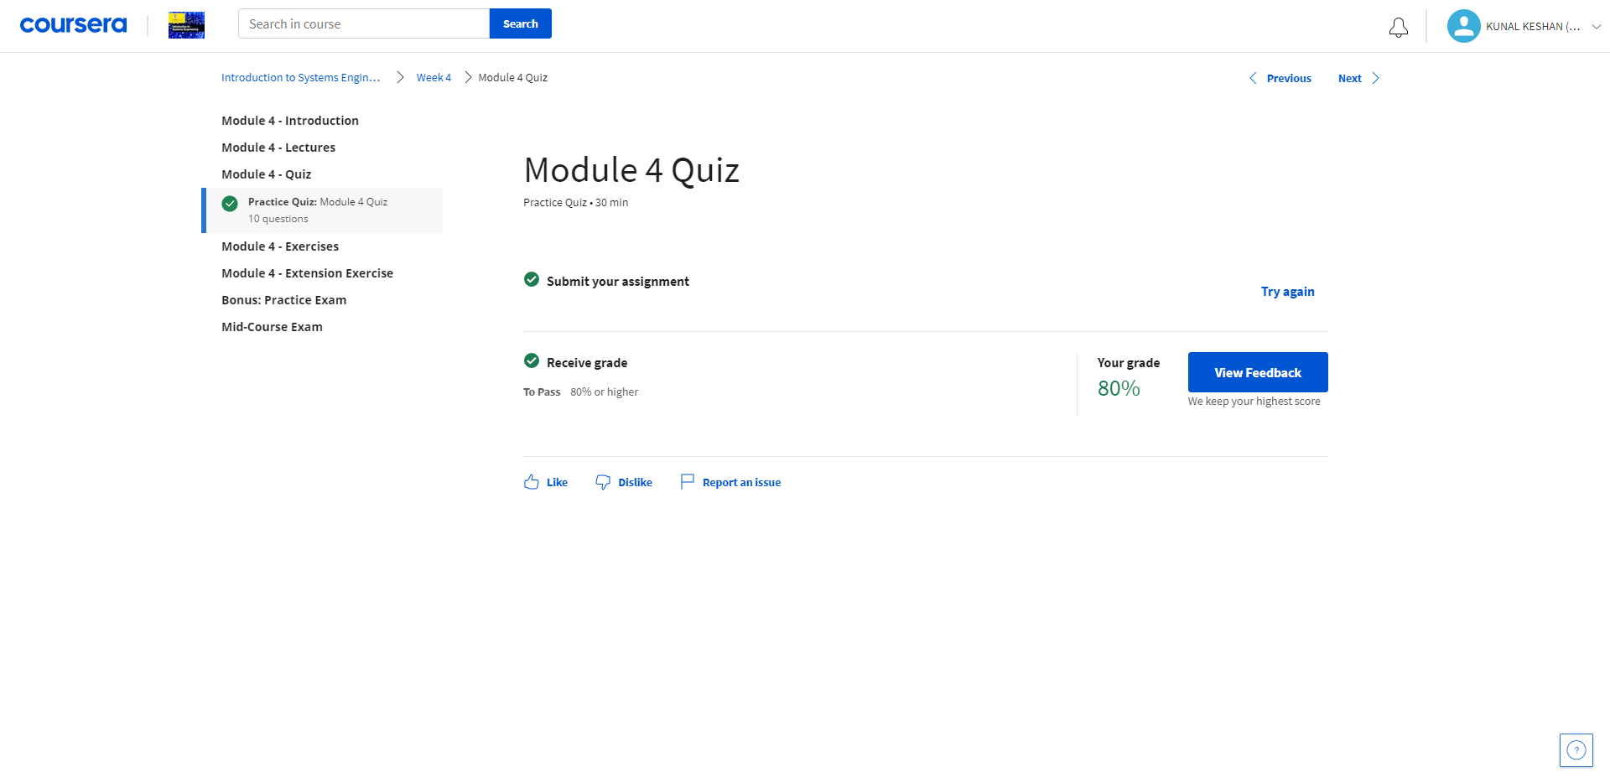
Week 4

Slide 16
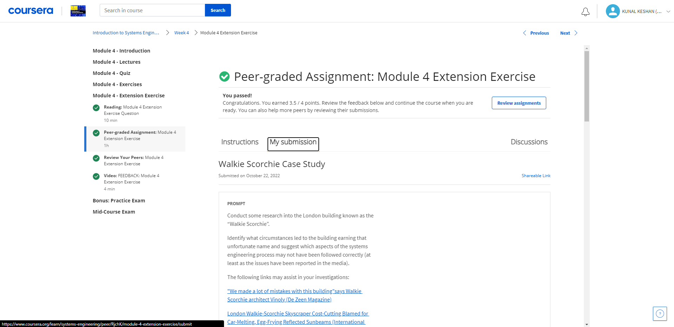
Week 4

Slide 17
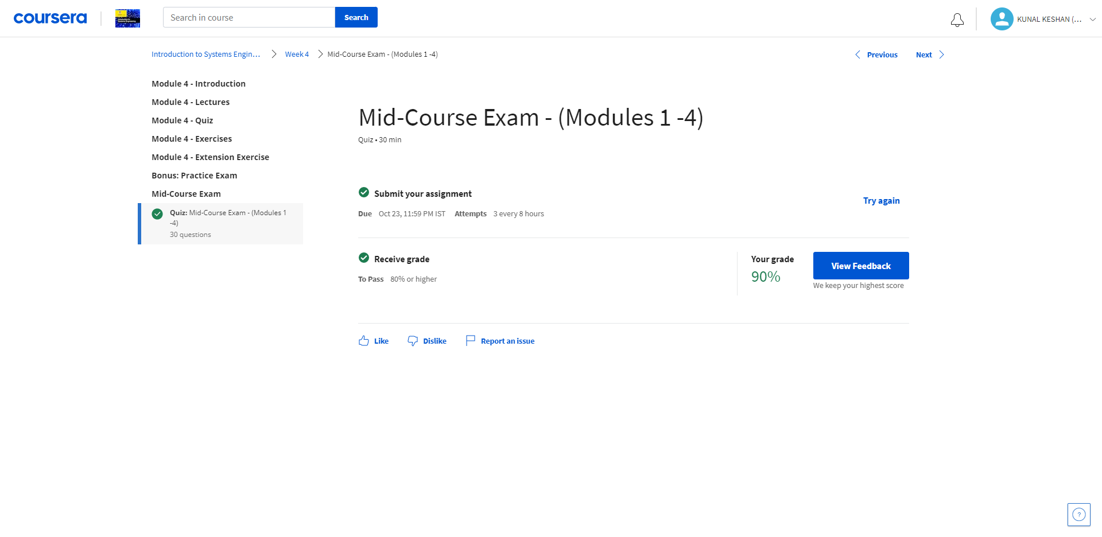
Week 4

Slide 18
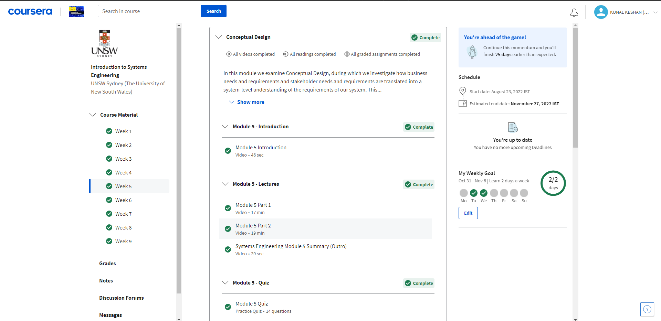
Week 5

Slide 19
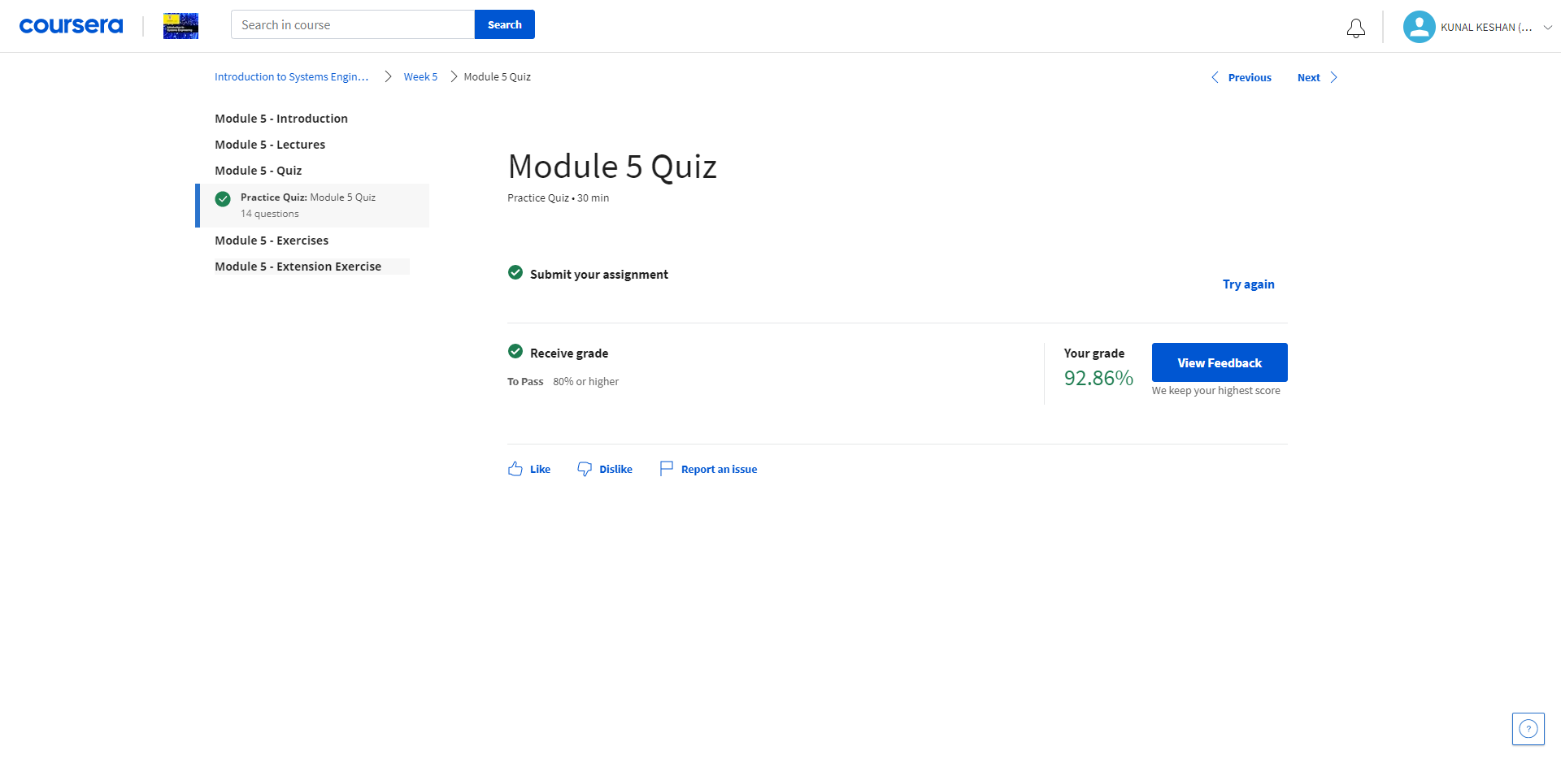
Week 5

Slide 20
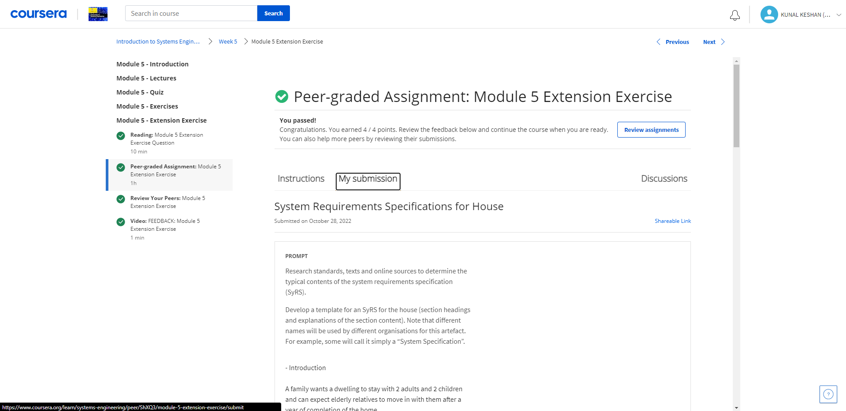
Week 5

Slide 21
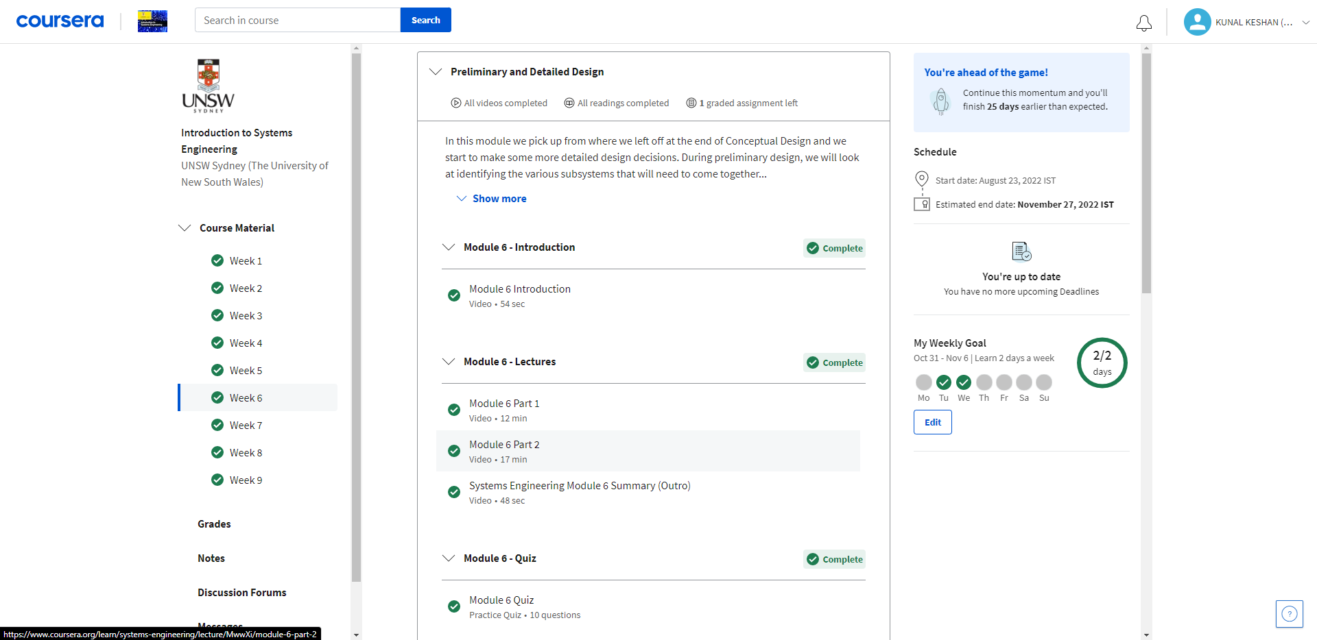
Week 6

Slide 22
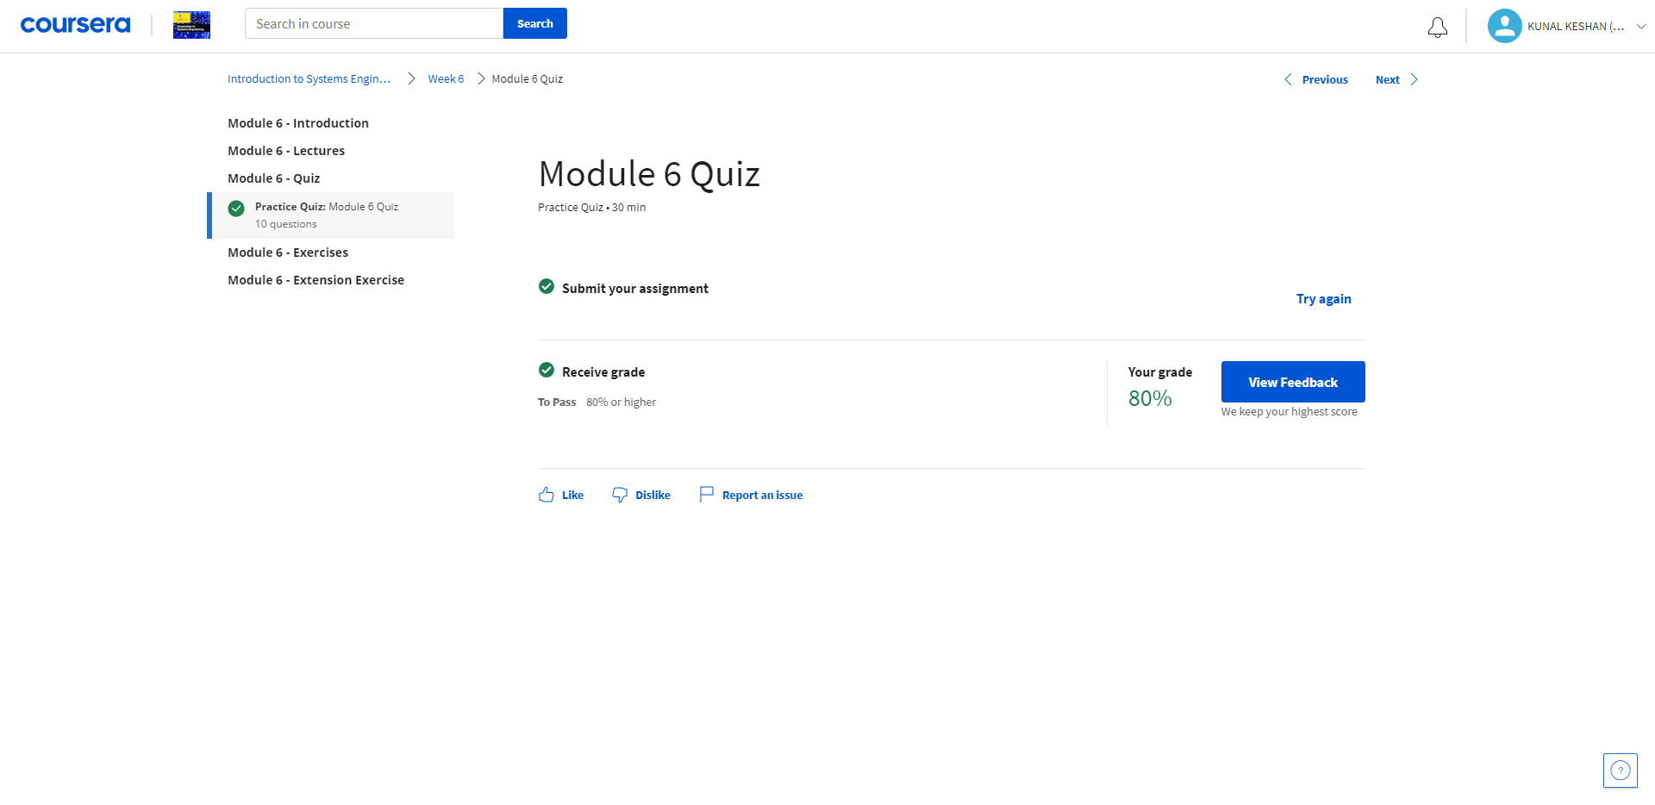
Week 6

Slide 23
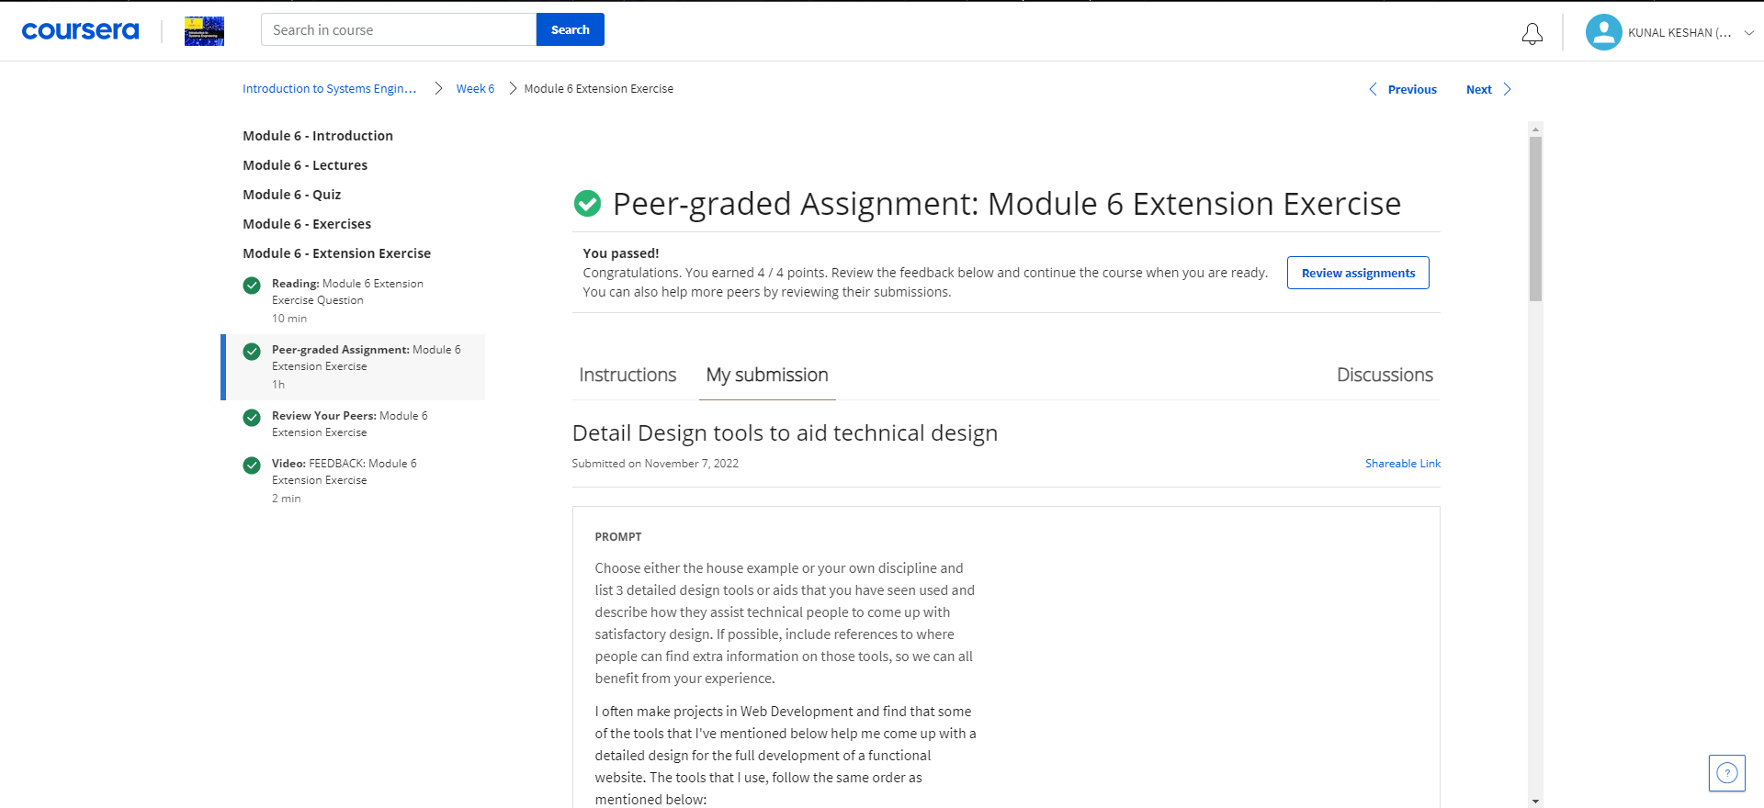
Week 6

Slide 24
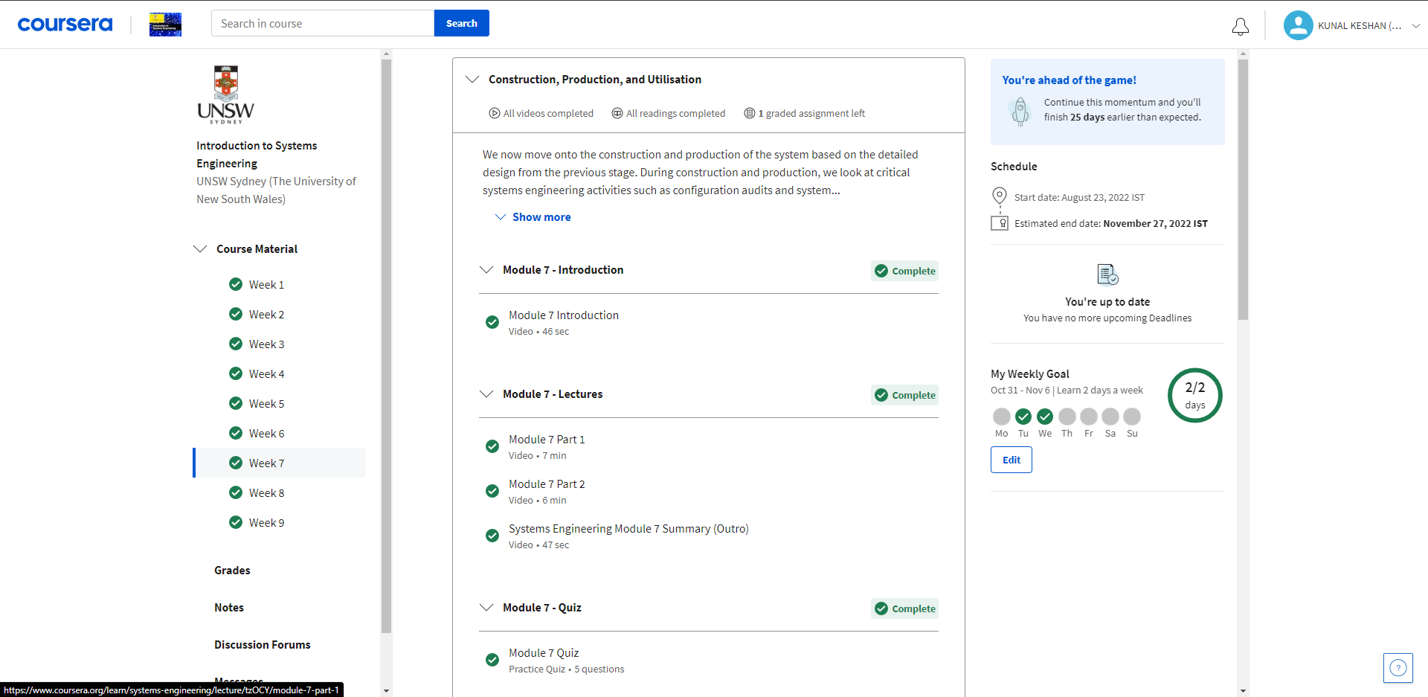
Week 7

Slide 25

Week 7

Slide 26
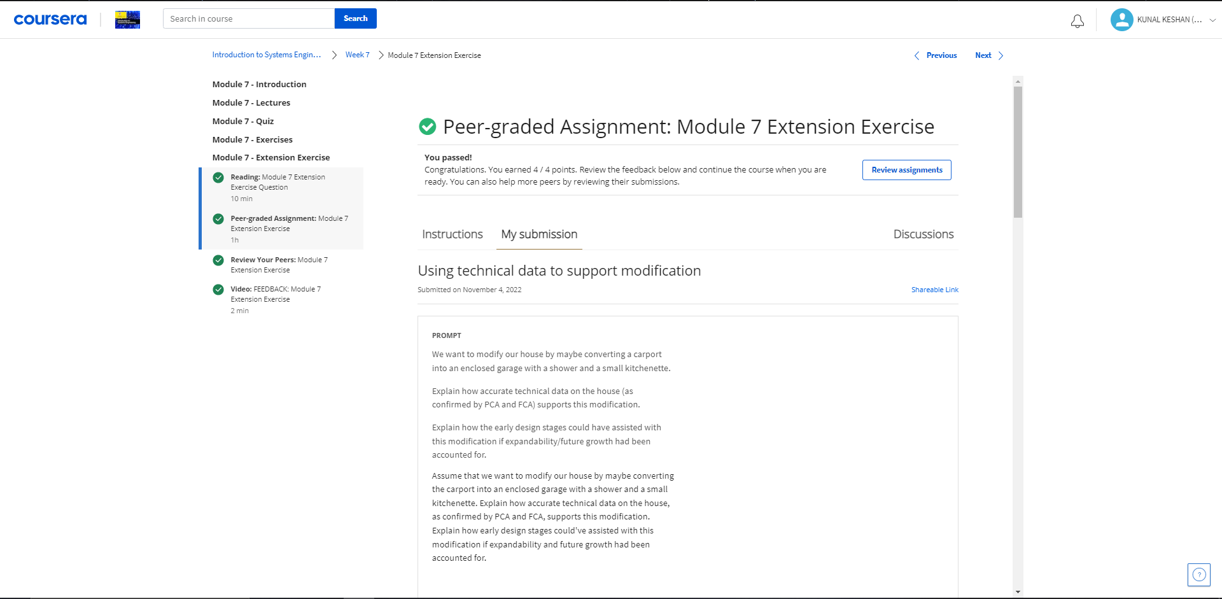
Week 7

Slide 27
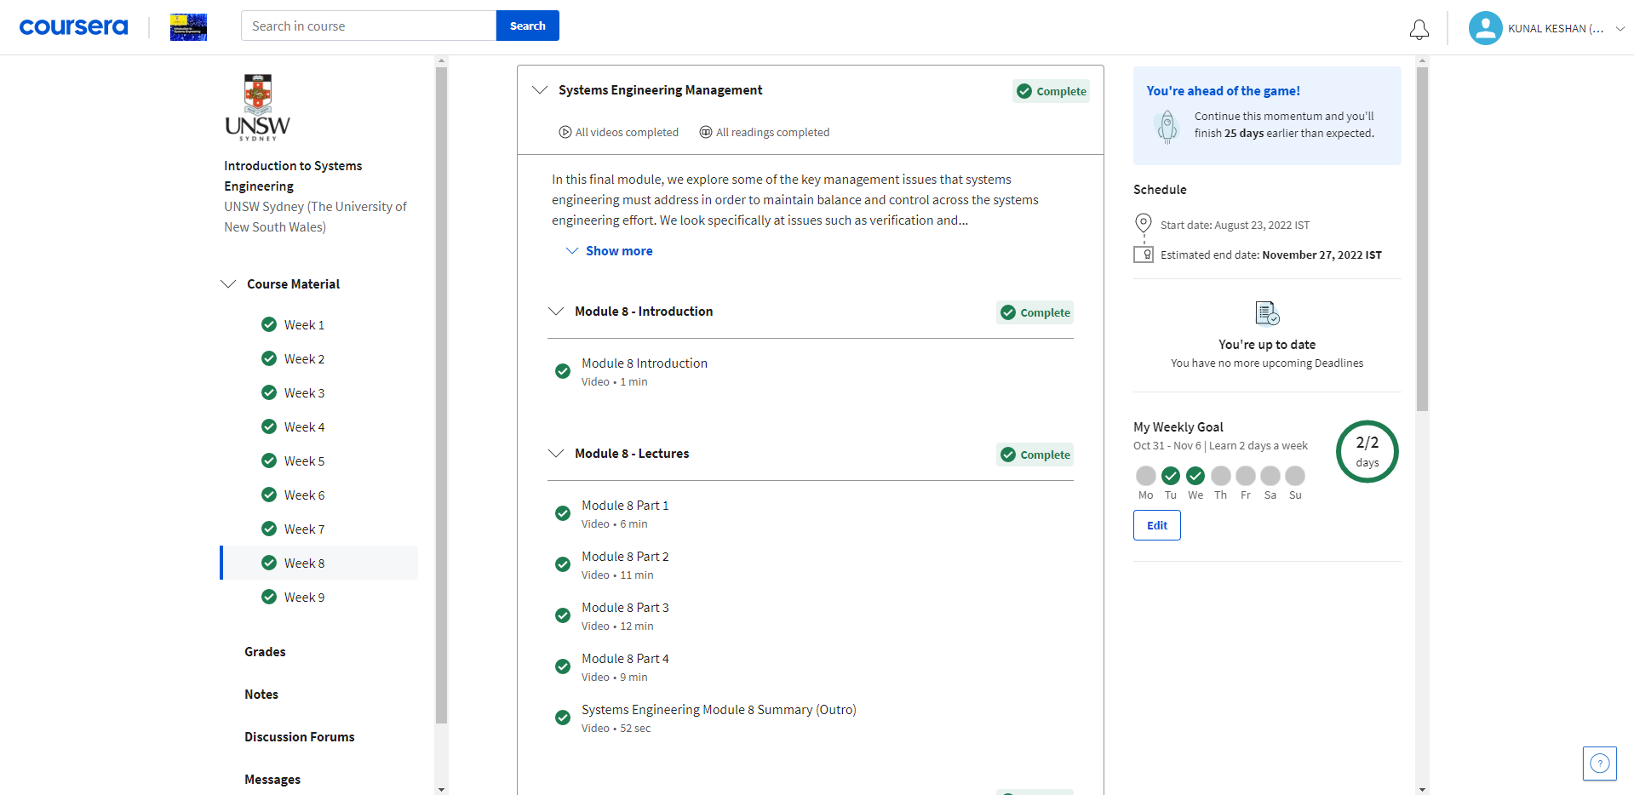
Week 8

Slide 28
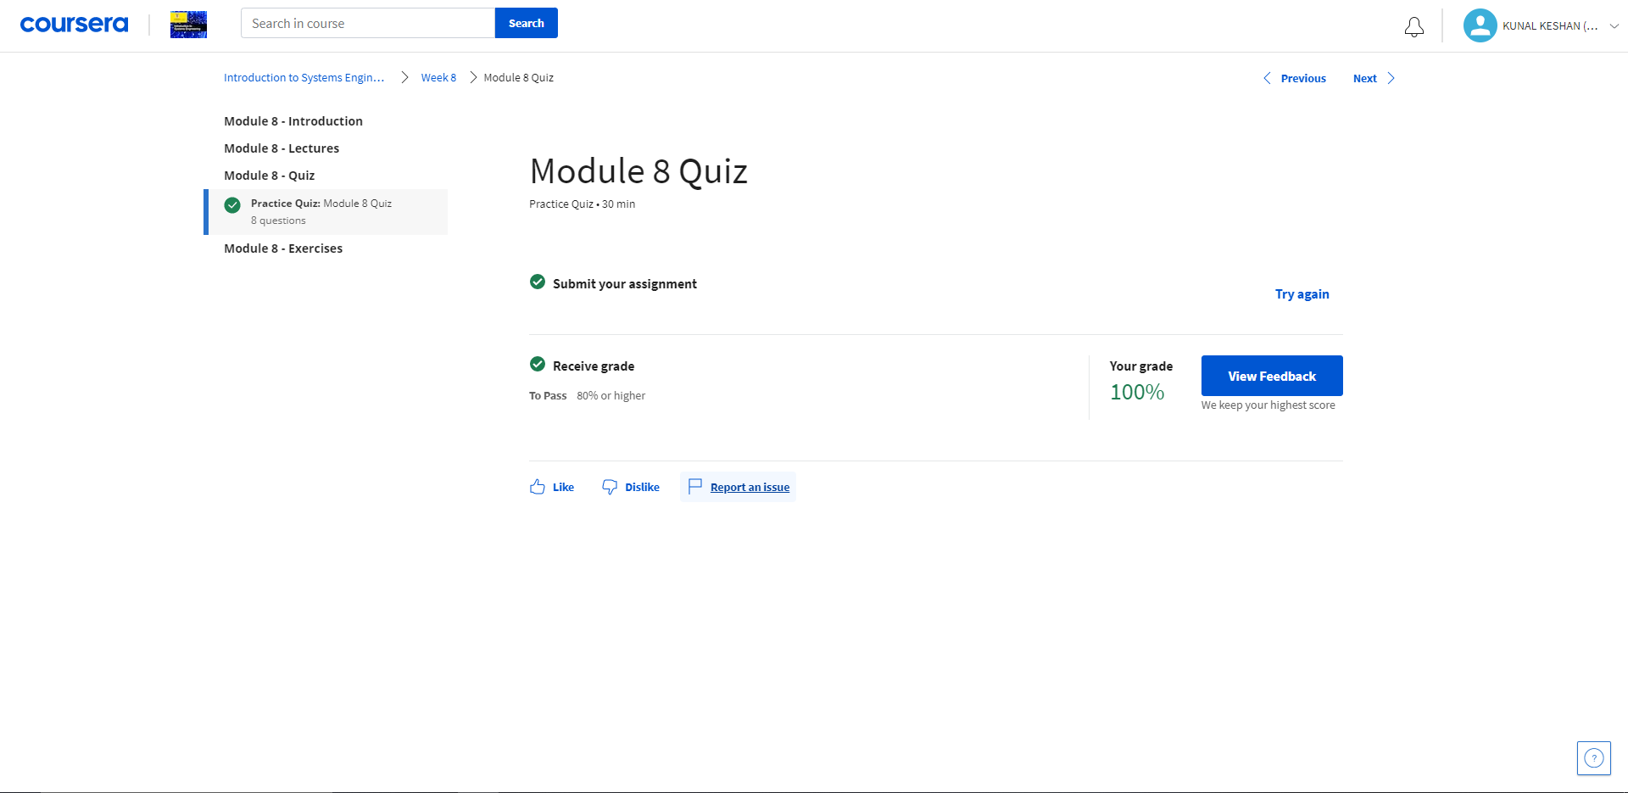
Week 8

Slide 29
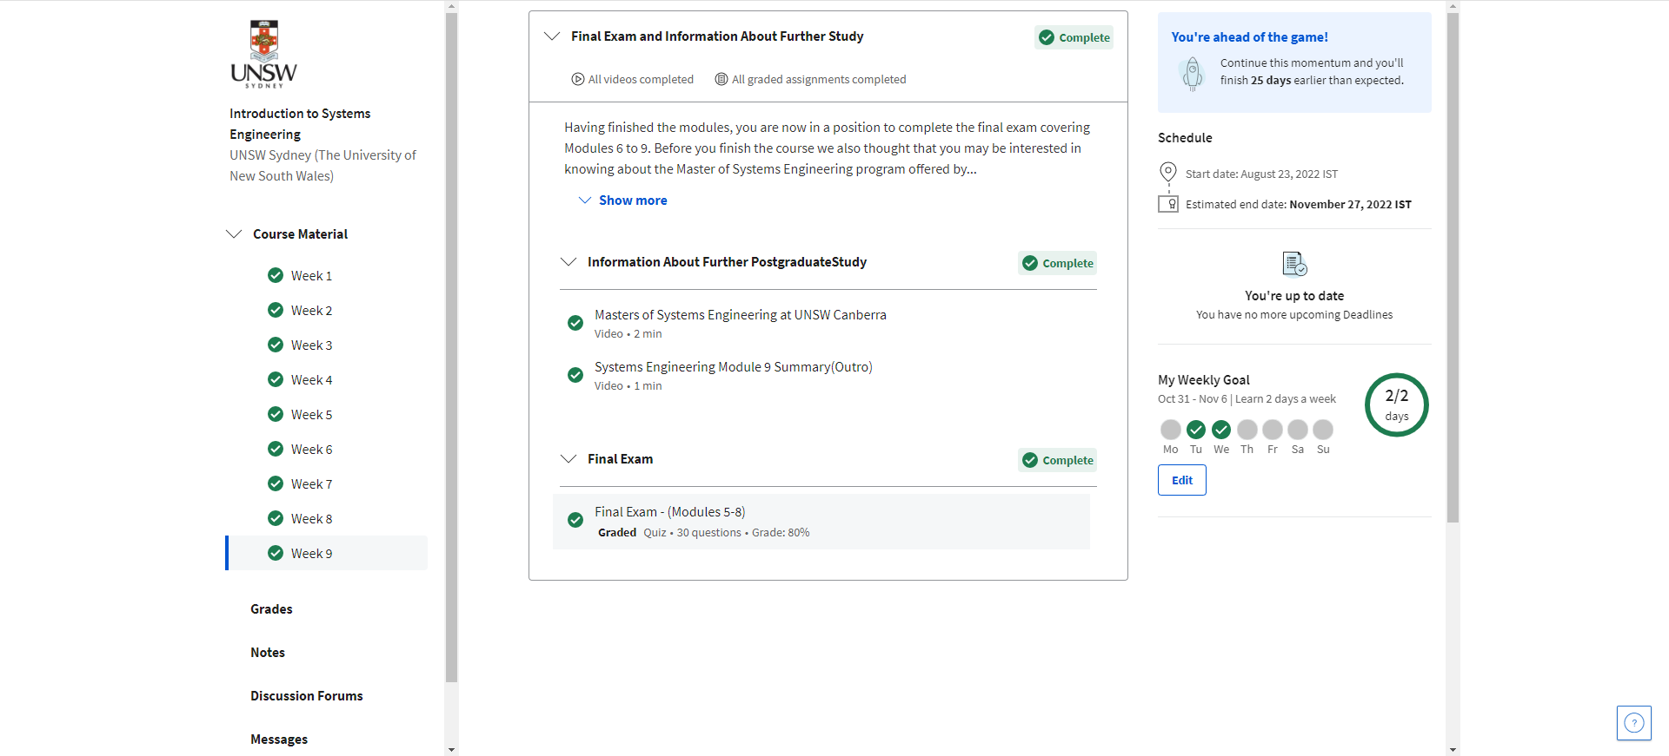
Week 9

Slide 30
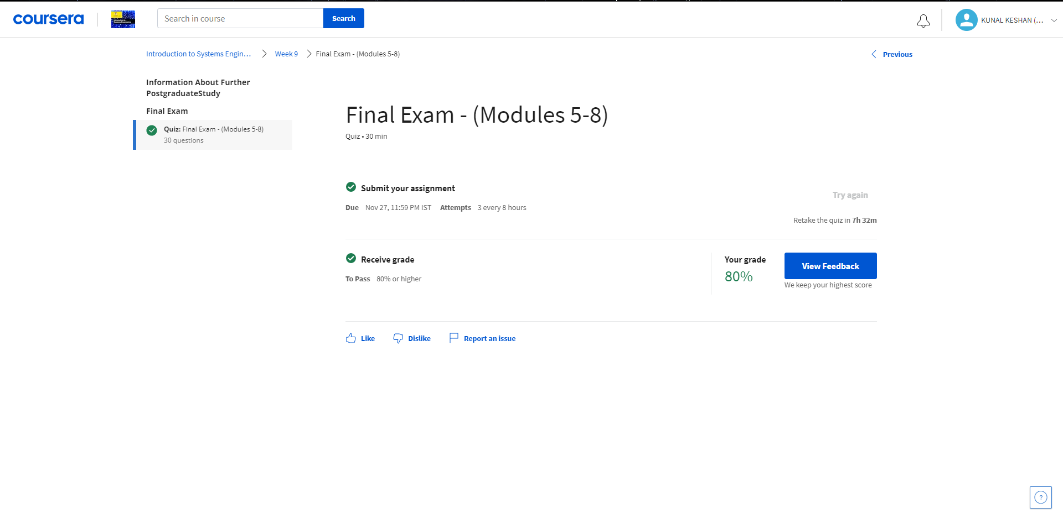
Week 9

Slide 31
Course Outcome
The course uses a structured yet flexible approach to provide a holistic, solid foundation to the understanding and development of complex systems. We take you step by step through the system life cycle, from design to development, production and management. You will learn how the different components of a system interrelate, and how each contributes to a project’s goals and success.
The course quizzes test your knowledge as you progress through the course.
The practical module exercises provide you with opportunities to apply the knowledge to real-world contexts.
The extension exercises and exams challenge and extend your understanding of the discipline, and develop deeper thinking skills.
We aim to provide you with a comprehensive introduction to the discipline, as well as a clear understanding of how the principles of systems engineering can be applied in a practical way to your context. We hope that by the end of the course, you will get a much better understanding of the relevance and benefits of the discipline as it relates to real world scenarios.

Slide 32
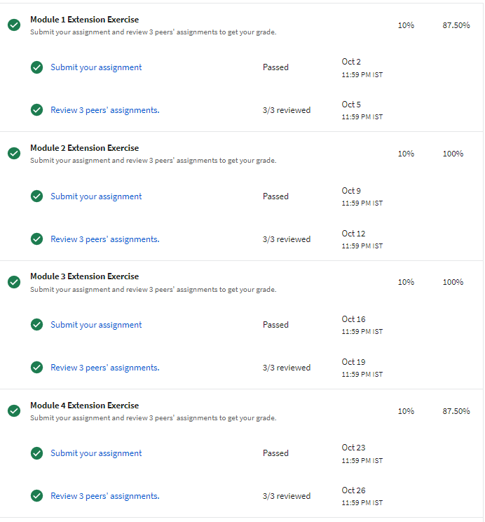
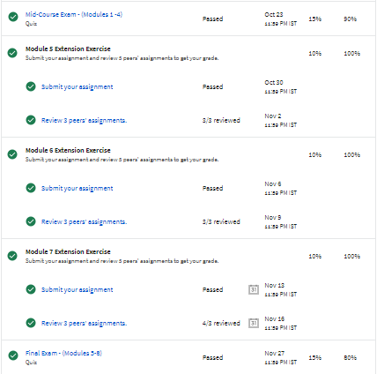
Course Grades

Slide 33
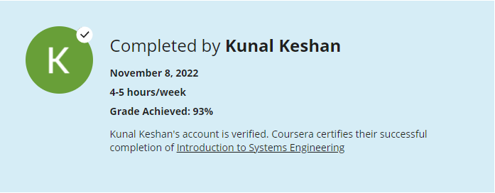
Proof

Slide 34
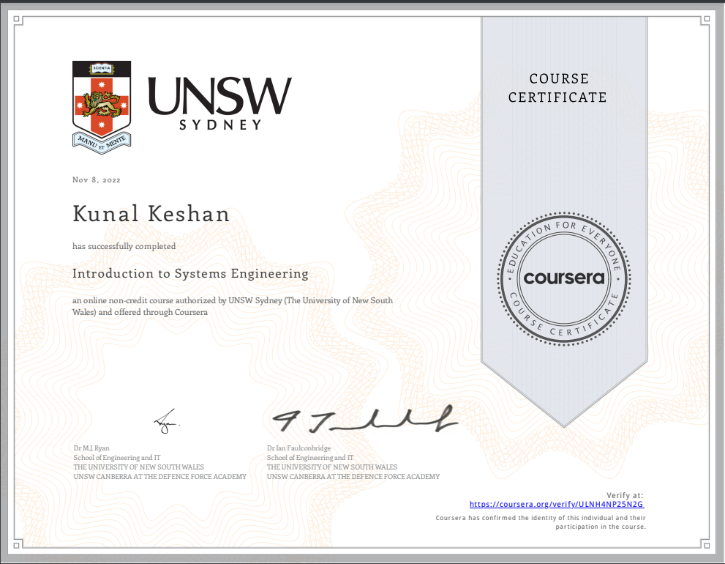
Certificate

